Slide 1






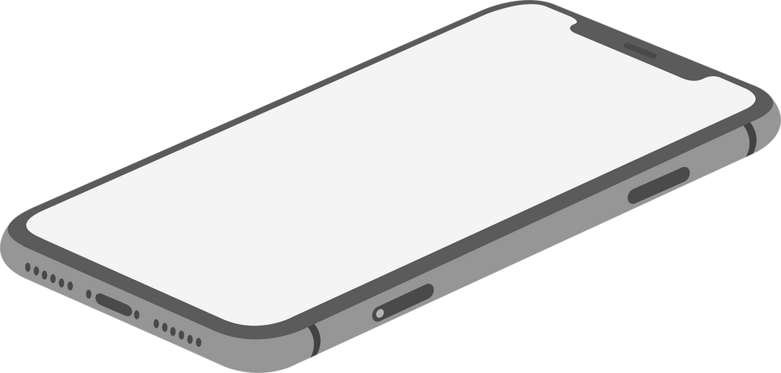


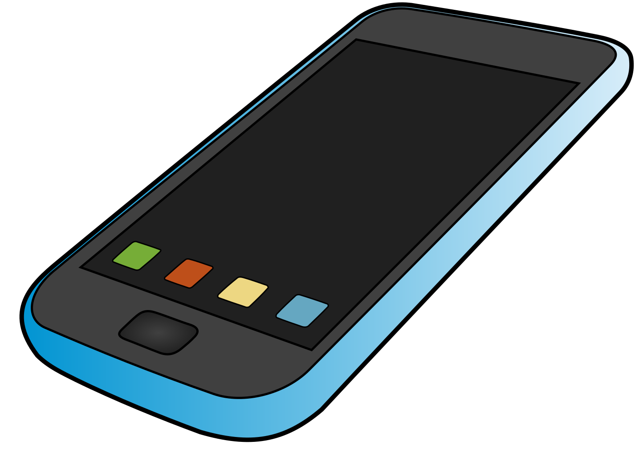




TEAM WARHAWKS
Presents
PhoneBook
PhoneBook
Know it Before Befriending it
Know It Before Befriending It
Sanjana Yadav Abhijit Kundu Sarthak Mishra

Slide 2
Problem
Solution
Unique Value Proposition
Unfair Advantage
Customer Segments
-When device is broken or facing some issues they are not getting immediate alternative
-Wasting their valuable time and effort while looking for alternatives
- Taking decisions in haste
- Buying a phone without knowing if it is the right phone for them
-Provide cheap alternative phones on cheap rental basis
- Provide trending phones on rental basis for customers to experience before buying
-Provide long term leases on phones.
We provide quick and easy replacement phones as rentals so that they have enough time to research which phone to buy
Customers can try different phones at extremely cheap rates.
Your Phone is like your Friend. Don't go by others' words, don't hurry, Know it before befriending it.
Mass Market
Though Initially, we are targeting Tier 1 cities only, India has more than 600 million smartphone users, and they all are in our Target customer group
Existing Alternatives
Key Metrics
High Level Concept
Channels
-RentoMojo
-Local Mobile shops
Sales Qualified Leads
Net Profit Margin
Quick Ratio
Customer Acquisition Cost
Conversion rate
Foot Traffic
Inventory turnover
Customer retention
Customer satisfaction
With so many phones flooding the market with similar specifications, and experts giving biased reviews, we want to give the power of making right choices back to the customer's hands.
Direct Marketing
Social media ads, Facebook Instagram, as a large part of our customer group is available on these platforms
Paid search campaigns
Word of mouth
Cost Structure
Revenue Streams
Purchase Cost
Advertising Cost
Labor Cost
Inventory Cost
Rental place cost
Rental service
Offline Sale of Devices
Mobile Insurance

Slide 3


